Slide 1
ACI EUROPE Annual Congress & General Assembly 2026

Slide 2
Presentation overview
Flight timing
Congestion
Airline concentration
Airport charges
Econometric analysis & entry/exit

Slide 3
Flight timing
Congestion
HHI / airline consolidation

Slide 4
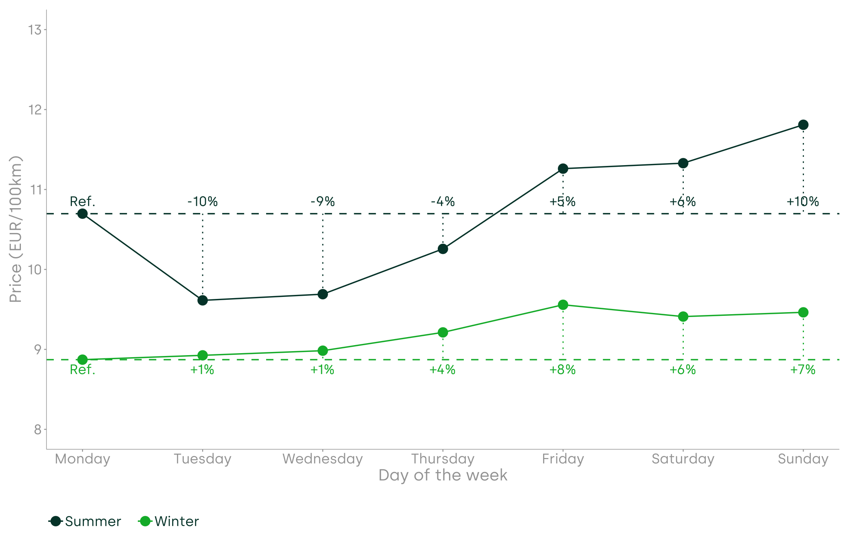
Day of the week
Variation in price by departure day and IATA season
Average fares are indexed to Monday
Percentage changes for other days are compared to the Monday baseline

Slide 5
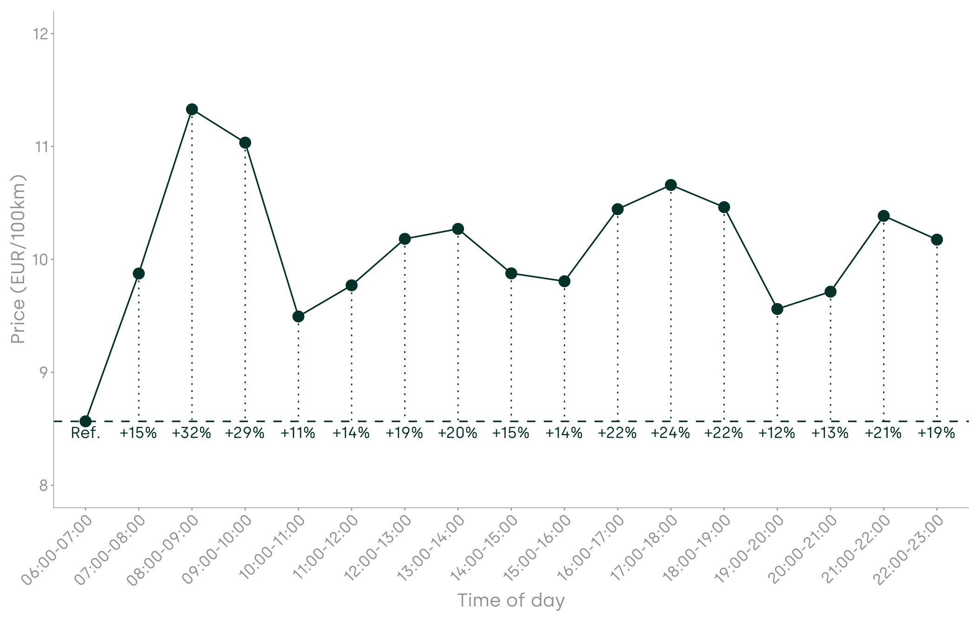
Time of day: departure
Variation in price by departure time band
Average fares are indexed to the 6-7am slot
Percentage changes for other time slots are compared to the 6-7am slot baseline

Slide 6
Flight departure/arrival time
Congestion
HHI / airline consolidation

Slide 7
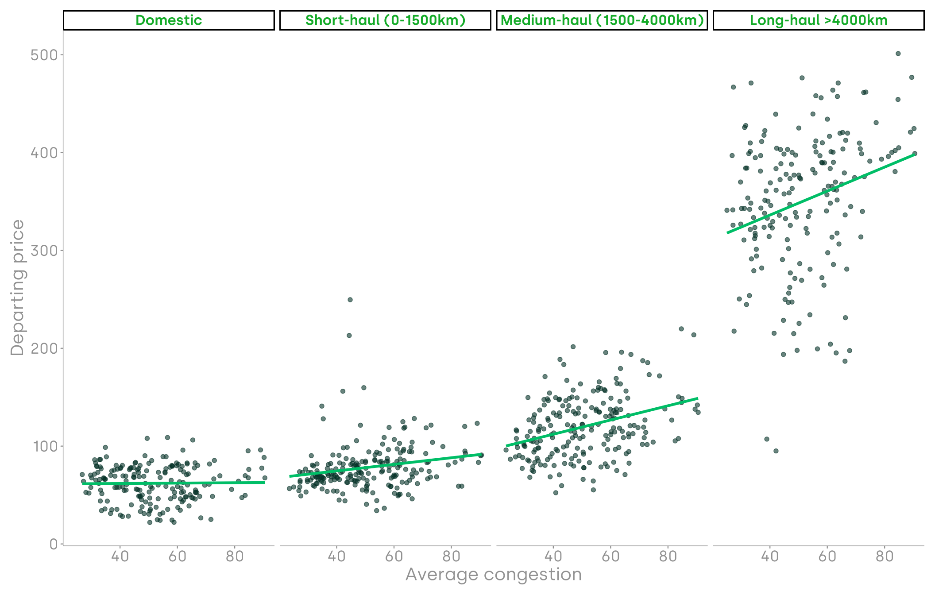
Congestion (I)
Relationship between average airport-level congestion and price (in levels, not standardised by distance)

Slide 8
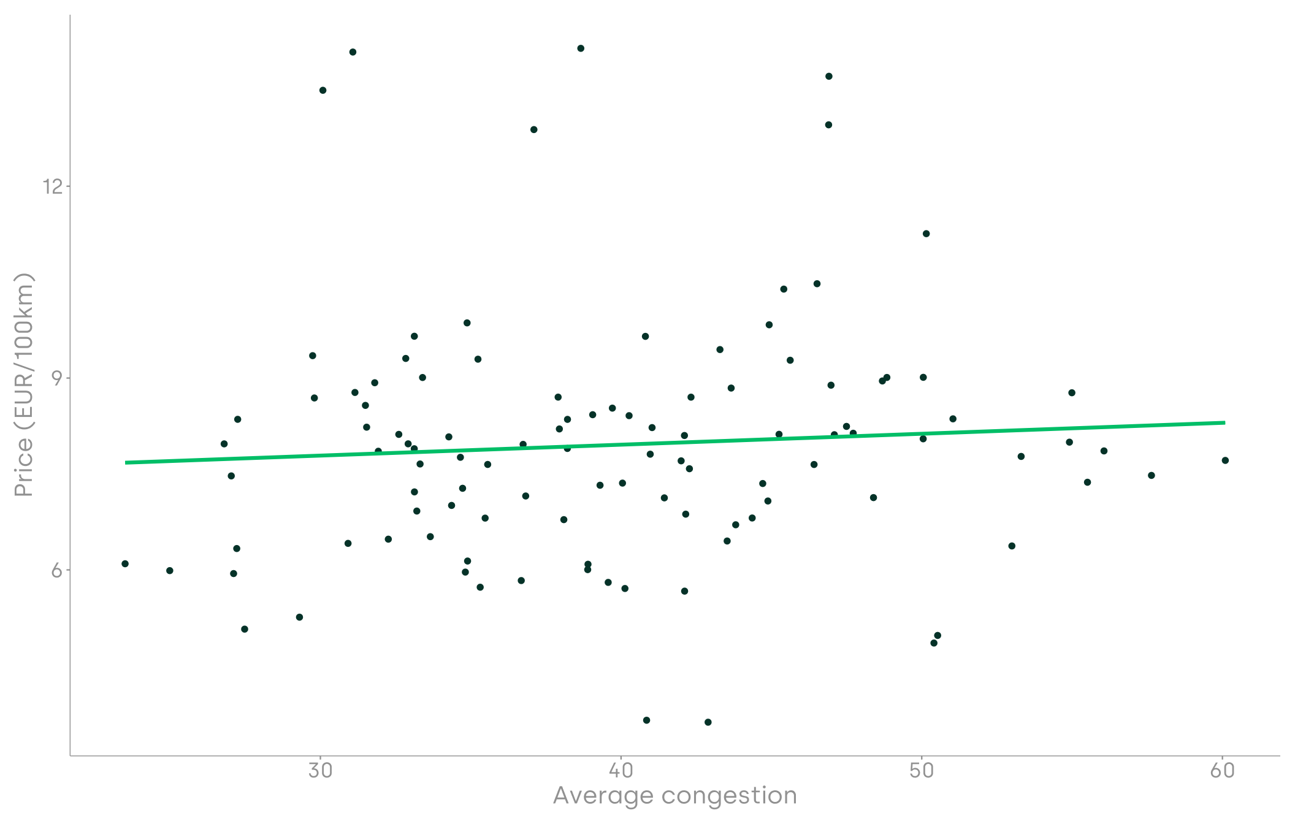
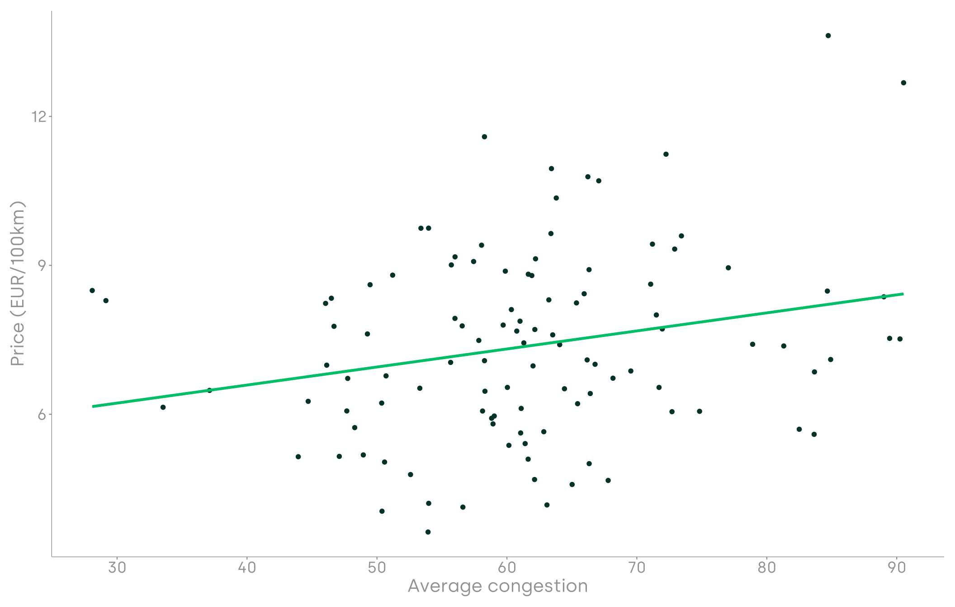
Congestion (II)
Relationship between airport congestion and price per 100km – depending on the level of congestion
Lower congestion sample (below median)
Higher congestion sample (above median)

Slide 9
Flight departure/arrival time
Congestion
Airline concentration

Slide 10
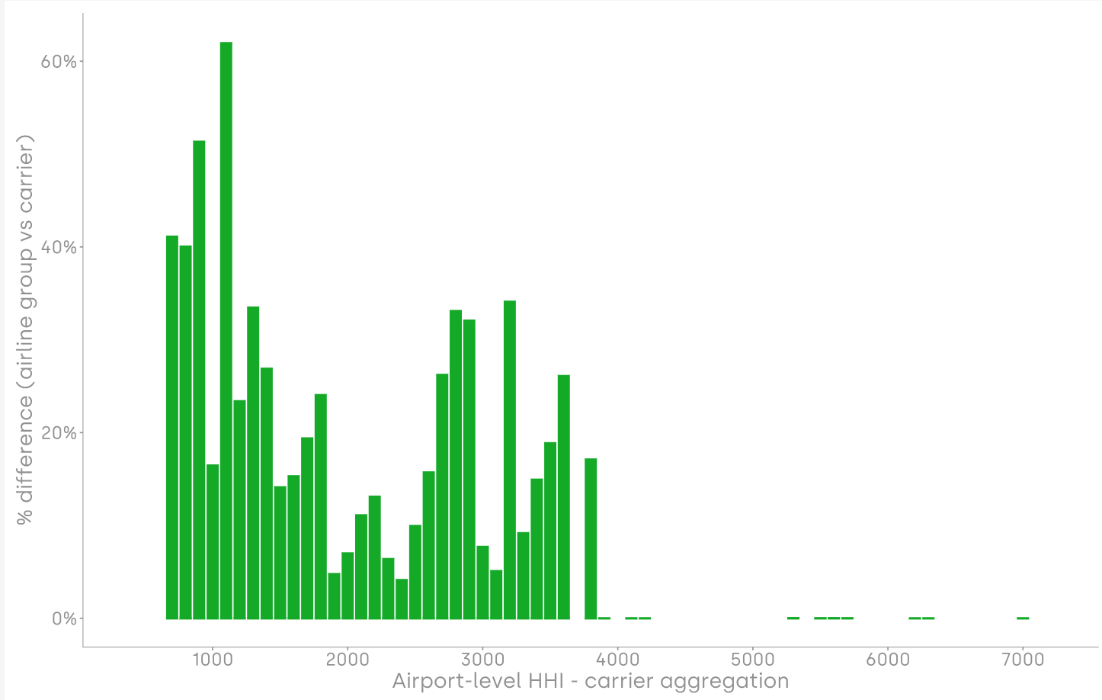
Airline concentration (I)
Difference in level of competition between the ‘carrier’ view and the ‘airline group’ view
More competitive routes
Less competitive routes

Slide 11
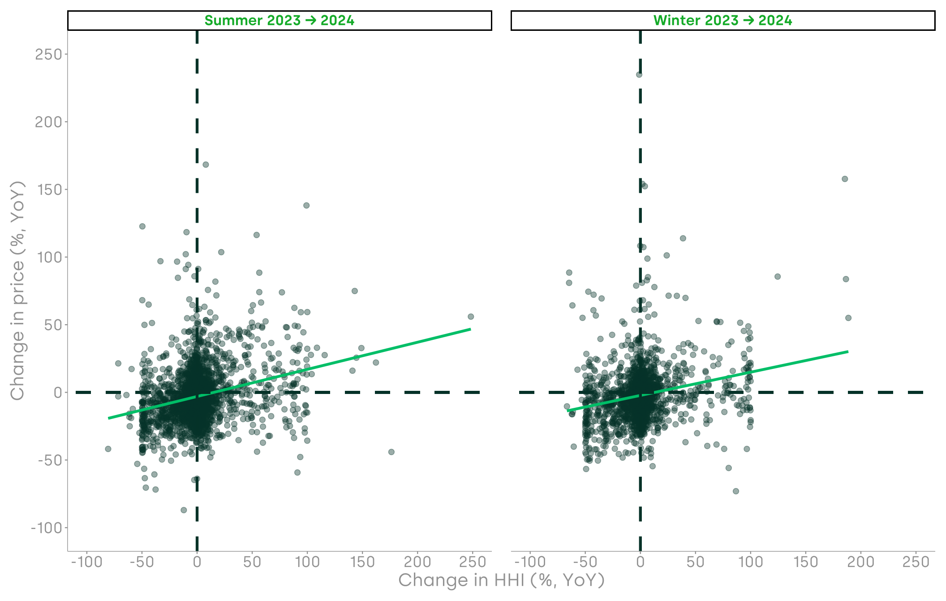
Airline concentration (II)
Relationship between YoY changes in route-level HHI and price

Slide 12
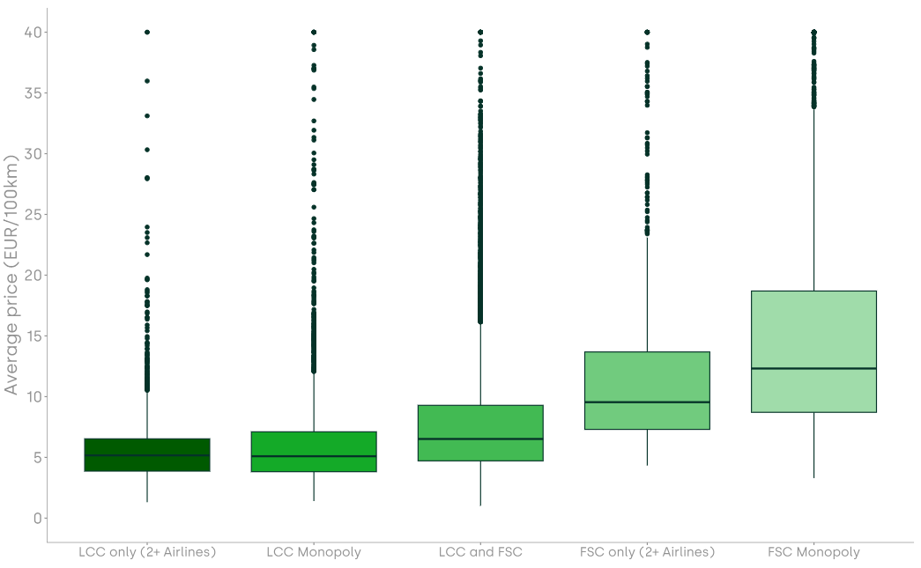
Airline concentration (III): LCC vs FSC fares by type of competition
Distribution of fares by type of competition on route – excluding LH

Slide 13
Airport charges

Slide 14
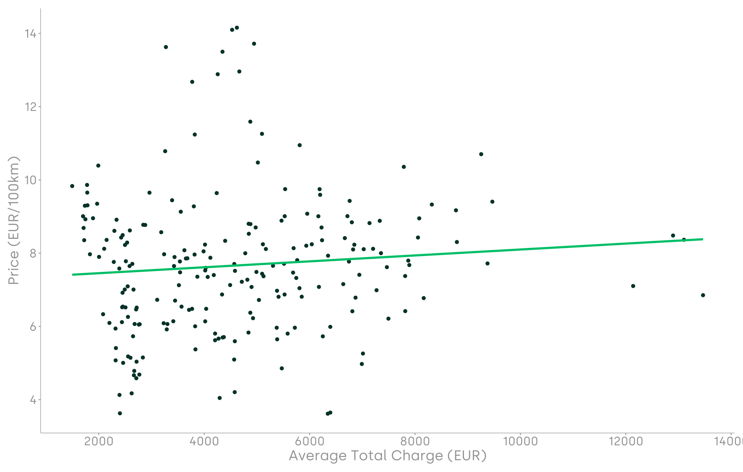
Average charges (I)
Relationship between average charges and price per 100km

Slide 15
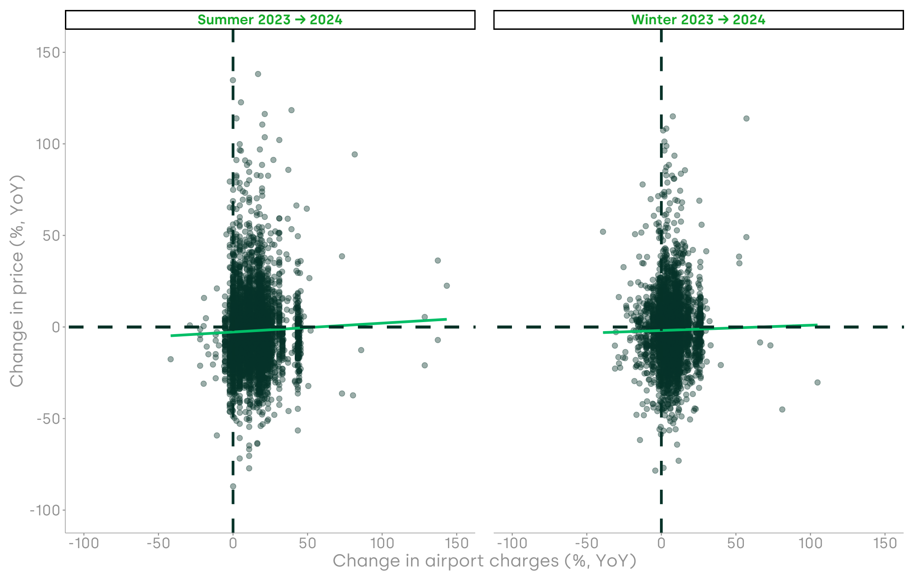
Average charges (II)
Relationship between year-on-year average charges and price per 100km

Slide 16
Econometric analysis & entry/exit

Slide 17
Impact of the key factors
Factor | Description | Price effect | Practical example
Airline concentration (city-pair level) | 10% increase in city-pair level concentration (HHI) by IATA season increases prices by… | 1.02% (€1.71) | Route shifts from 50/50 distribution of seats to 66/34 (between two carriers)
Airport congestion | 10% increase in monthly airport-level congestion increases prices by… | 0.91% (€1.57) | Airport moves from 50% to 55% average congestion
Airport charges | 10% increase in total turnaround charges increases prices by… | 0.35% (€0.61) | Per-flight charge rises from €5,000 to €5,500
Entry is associated with fare reductions from 5.0% to 8.1% (6.6% on average)
Exit is associated with fare increases from 7.1% to 12.0% (8.5% on average)
Notes: Model dependent variable city-pair level fares by IATA season. Fixed effects controlling for time variations (IATA seasons) and distance also included. All factors reported are significant at 1%.

Slide 18
Key takeaways

Slide 19
Key takeaways from our analysis
Demand is central - most fare variations are explained by variations in demand and, as a result, dynamic pricing from airlines
Less airline competition leads to higher fares, while the type of competition also matters
Lack of airport capacity leads to more congested airports and higher fares, confirming the existence of a scarcity premium
Airport charges are a marginal cost driver

Slide 20
Implications for the Fitness Check
Congestion is costly to all stakeholders in the aviation sector - managing congestion should be a policy priority
Regulators should recognise the need for investment in airports – airport investment leads to benefits for passengers that outweigh their costs
Passengers benefit significantly from airline competition (including through entry/exit), but are paying fare (scarcity) premiums due to the lack of competition

Slide 21
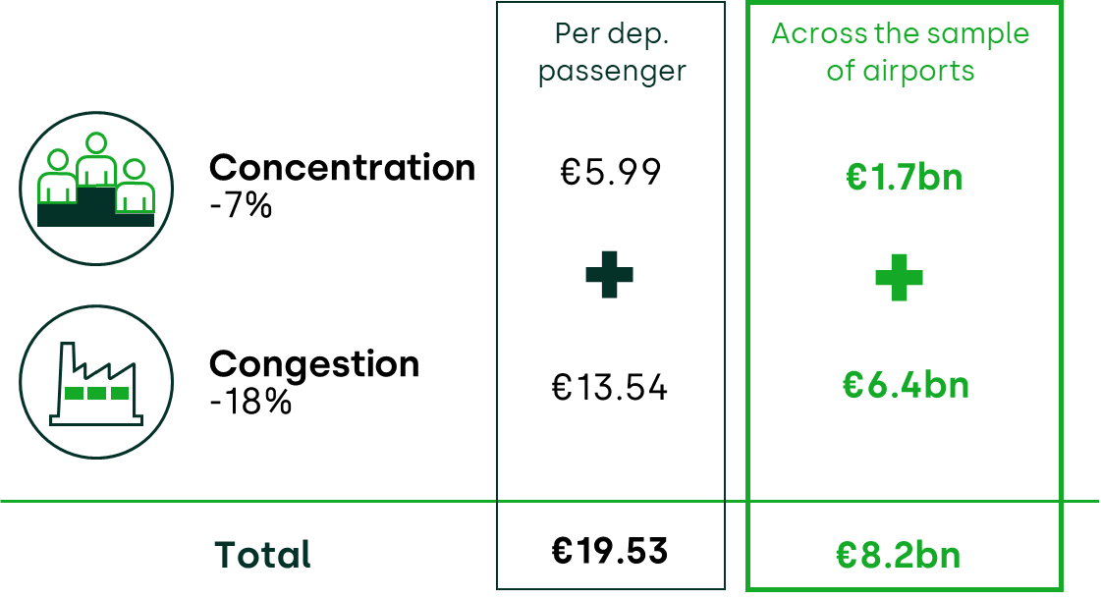
Estimated benefit to passengers of reducing concentration and congestion at European airports

