Slide 1

BUILDING YOU
A BETTER AIRPORT
Martin Kučera, Member of the Board of Directors
23rd June 2026

Slide 2
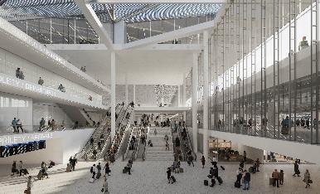
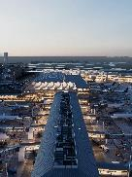
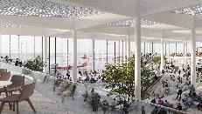
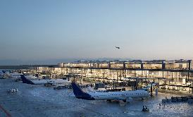
BUILDING YOU A BETTER AIRPORT
Prague Airport is launching the most ambitious modernisation in its history.
It is not only about new buildings, but about preparing the airport for future demand, improving passenger experience, enhancing operational resilience and supporting the Czech Republic’s international connectivity.
z
z

Slide 3
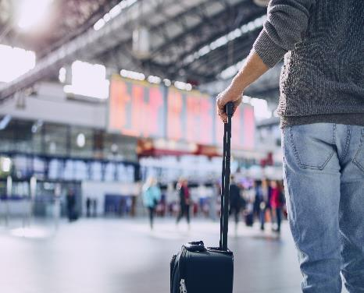
DEMAND IS GROWING. Passenger expectations are changing. Infrastructure must stay ahead.
Prague Airport is returning to record traffic levels.
Expected traffic in 2026: almost 19 million passengers.
Current terminal infrastructure is under increasing pressure.

Slide 4




THIS CHANGE IS NOT JUST TECHNICAL, IT IS STRATEGIC.
Improving airport accessibility
Increasing comfort and smoothness of handling
Modernising security and technological infrastructure
Enhancing sustainability and operational efficiency
Every project must contribute to transform the aiport into a future-ready gateway that is efficient for airlines, comfortable for passengers, reliable for partners and responsible towards its our neighbourhood.

Slide 5
OUR APPROACH: OPTIMISE FIRST, BUILD WHERE NEEDED.
Safety
000000
000000
01
02
03
04
Sustainability
Robustness
RETHINK
OPTIMISE
ADAPT
BUILD NEW CAPACITY
Flexibility
Challenge the need and sequencing
Use existing assets better first
Upgrade what already exists
Only when demand requires it
Economic responsibility
The four-step principle makes the programme more manageable, more transparent and more economically responsible.

Slide 6
TODAY’S BOTTLENECKS
Terminal capacity and passenger flows
Limited flexibility between Schengen and non-Schengen flows, insufficient capacity in waiting areas for aircraft with up to 240 passengers.
Security and border control
Decentralised security screening in Terminal 1 is less efficient operationally and less comfortable for passengers.
Aircraft stands and apron flexibility
The airport needs more flexible stands, including positions to handle one-wide body aircraft or two narrow-body aircrafts.
Runway system
Long-term runway system requires modernisation to support future demand and operational resilience.

Slide 7
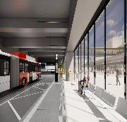
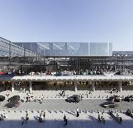
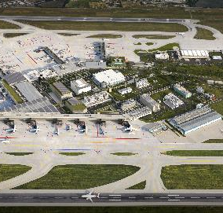

THREE STAGES OF TRANSFORMATION
STAGE 4
STAGE 3
STAGE 1
STAGE 2
STAGE 3
Improved accessibility
and parking
Increased comfort and faster handling
Modernisation of runway system
IMPLEMENTATION 2025–2030
IMPLEMENTATION 2029–2033
IMPLEMANTATION 2030+

Slide 8
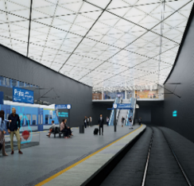
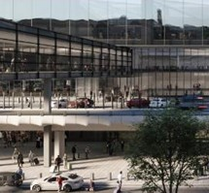
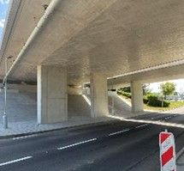
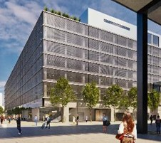
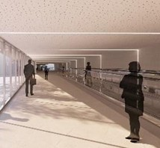
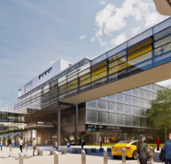
STAGE 1: IMPROVED ACCESSIBILITY AND PARKING
Railway
connectivity
FLYOVER
MOTORway D7 interchange
Parking and PMT facilities
Rail to
Terminal ACCESS
Skywalk
Creating a clearer, safer and more efficient lanside environment.

Slide 9
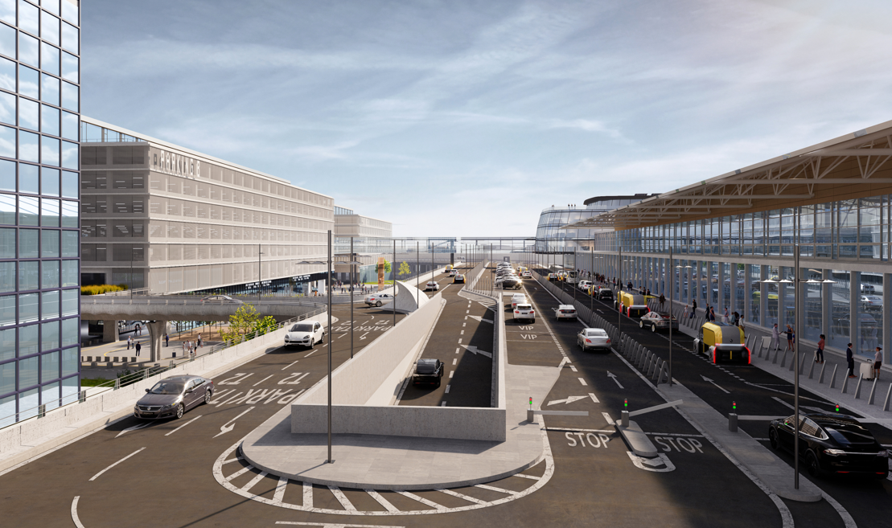

FLYOVER

Slide 10
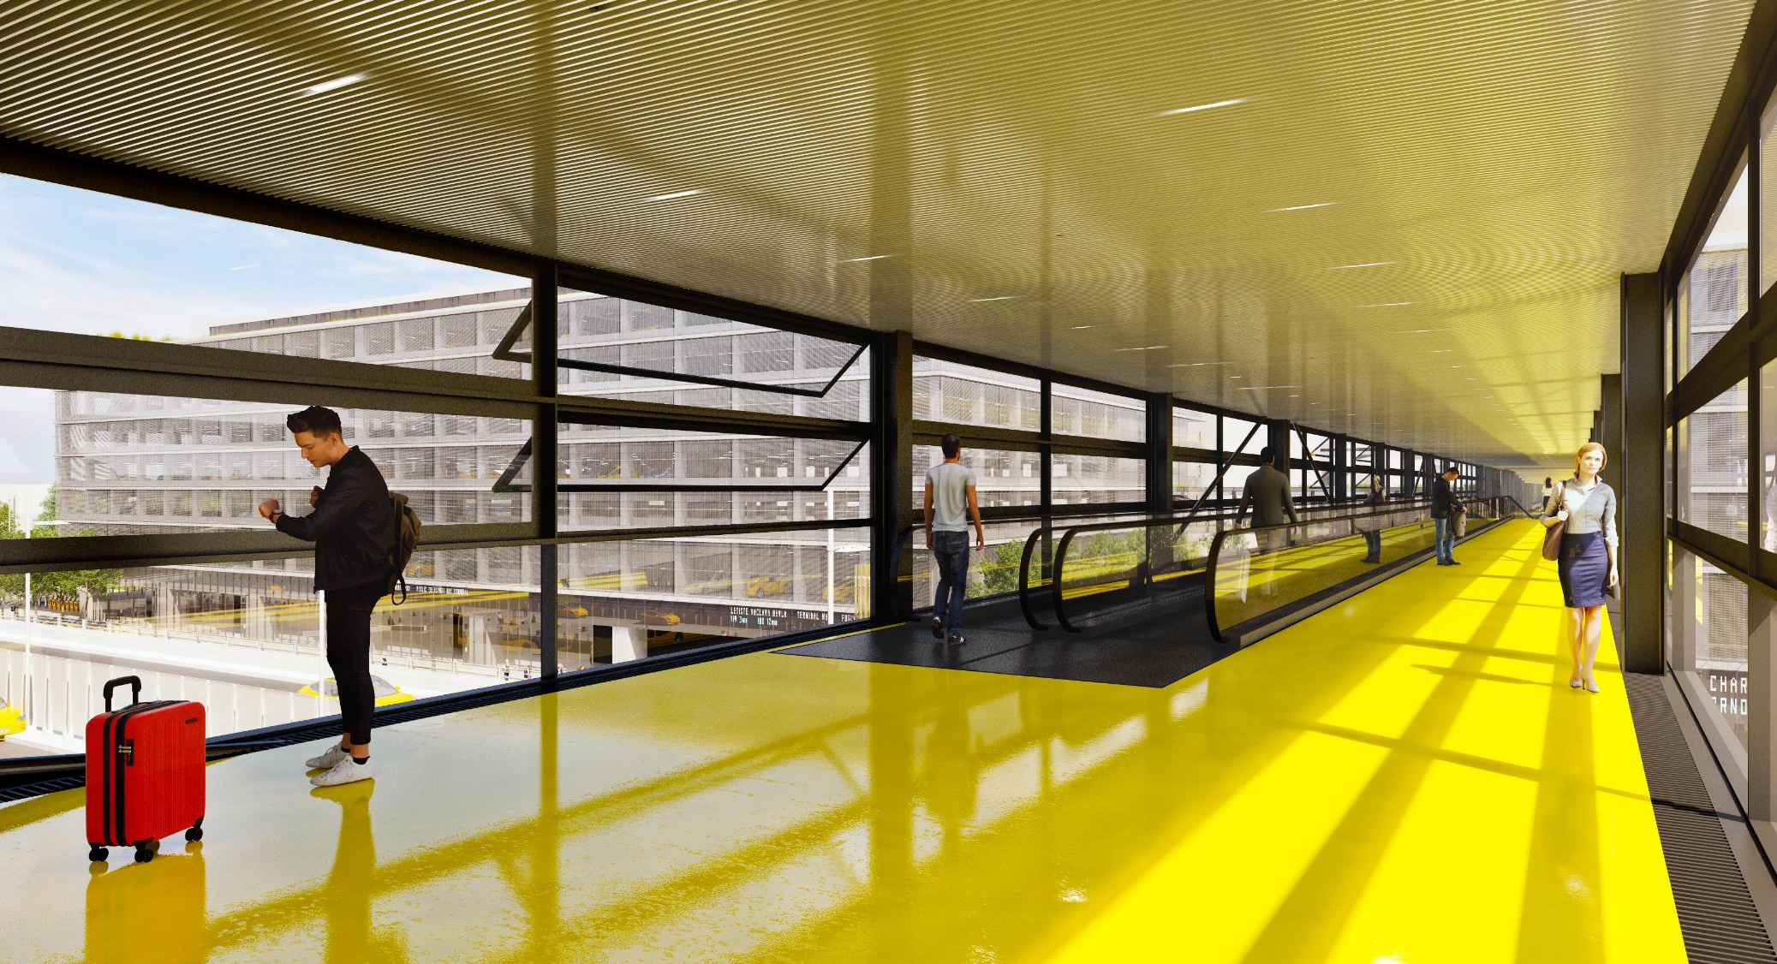
SKYWALK

Slide 11
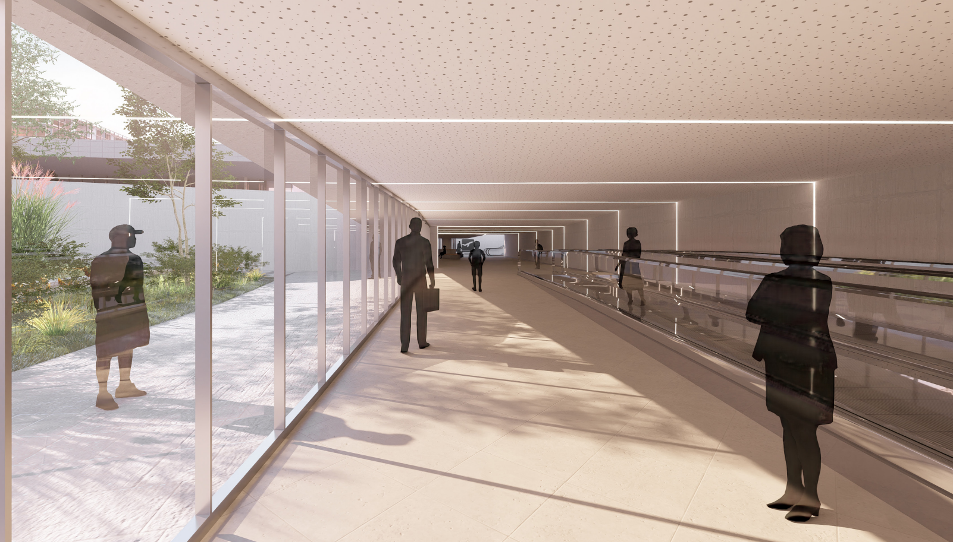
RAIL TO TERMINAL 1 ACCESS

Slide 12
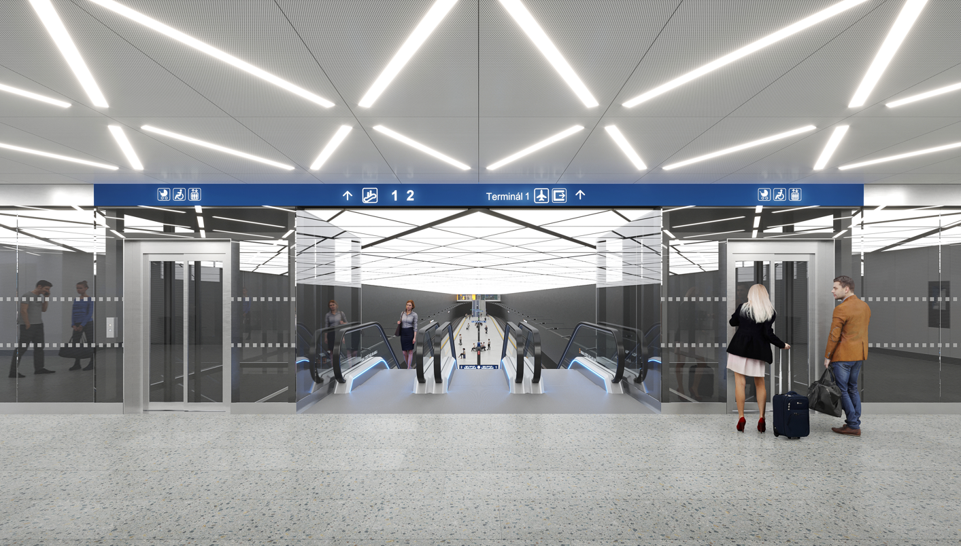
RAIL TO TERMINAL 2 ACCESS

Slide 13
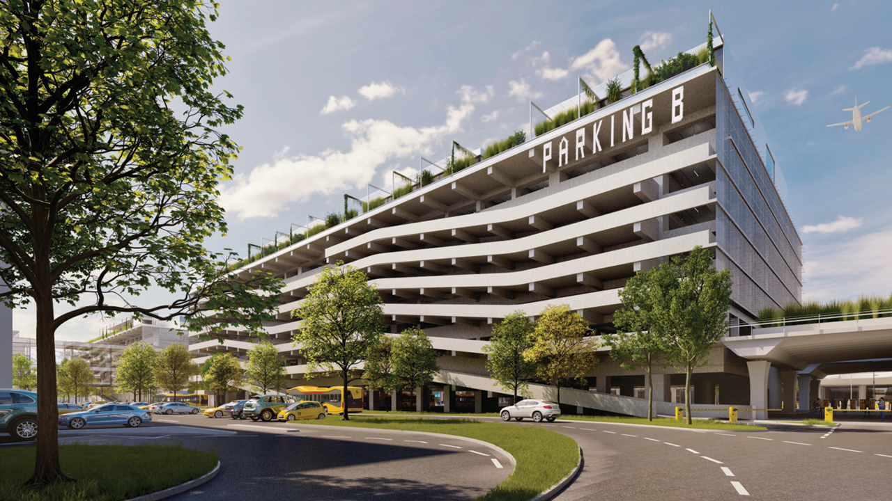
PARKING AND PMT TERMINAL

Slide 14

PUBLIC TRANSPORTATION TERMINAL

Slide 15
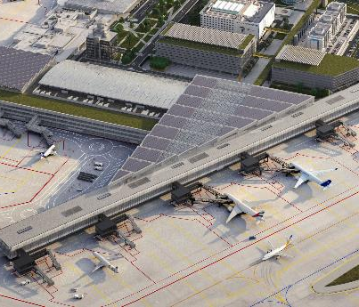
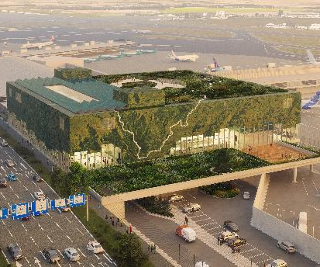
STAGE 2: INCREASED COMFORT AND FASTER HANDLING
Terminal 2 exPAnsion
Terminal 1 exPAnsion
Creating a more flexible terminal, able to better handle peak demand, different passanger flows and future airline requirements.
Central security screening at Terminal 1 is one of the most important operational changes: from a fragmented process to a more efficient and future-proof model.

Slide 16
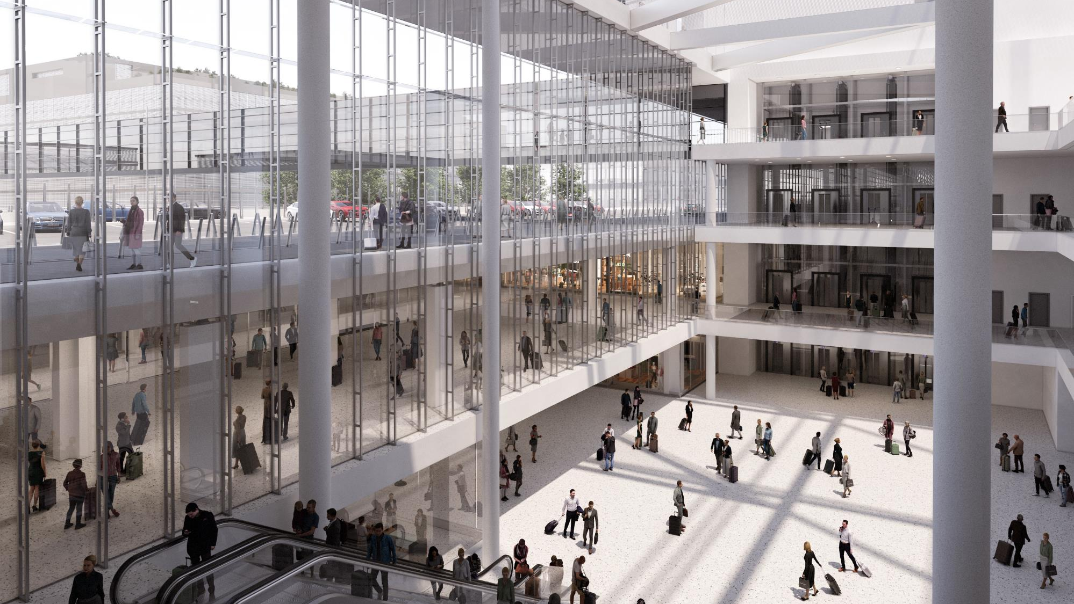
TERMINAL 2 EXPANSION – PUBLIC ZONE

Slide 17
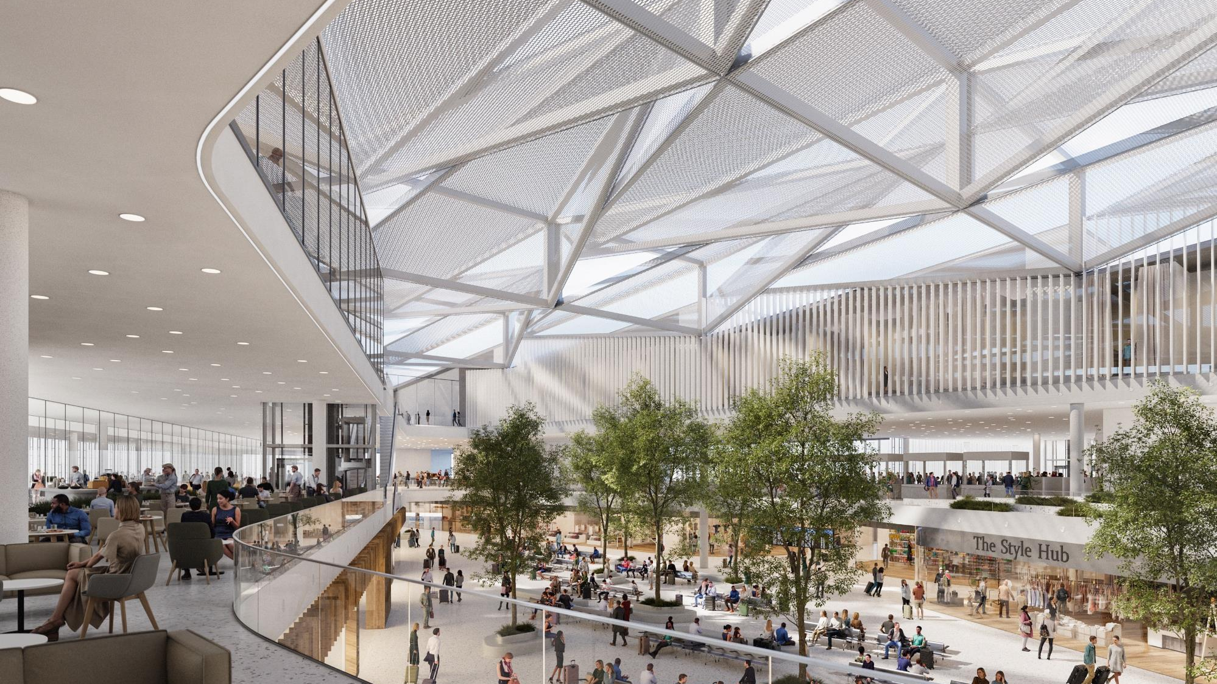
TERMINAL 2 EXPANSION – NON-PUBLIC ZONE

Slide 18
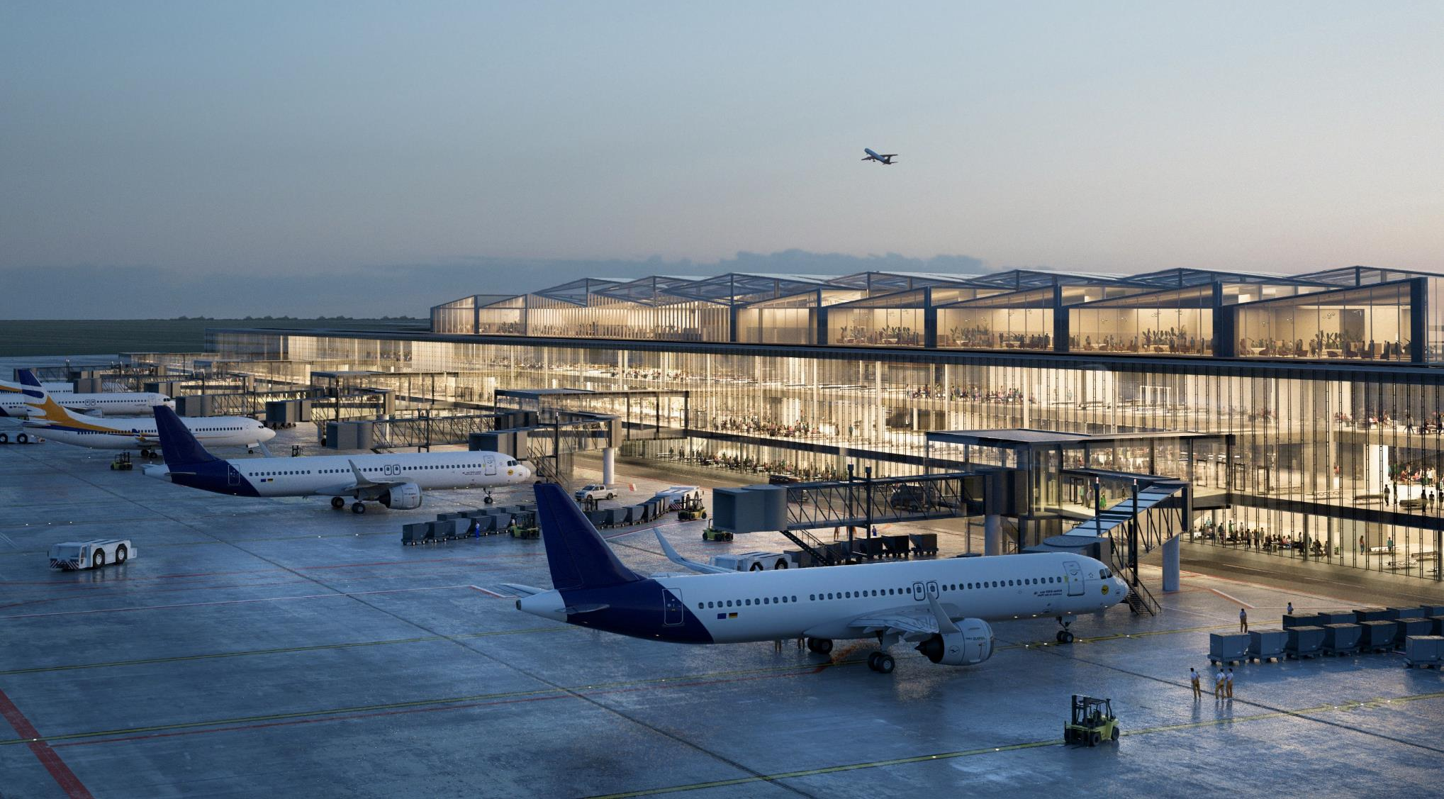
TERMINAL 2 EXPANSION – PIER D

Slide 19
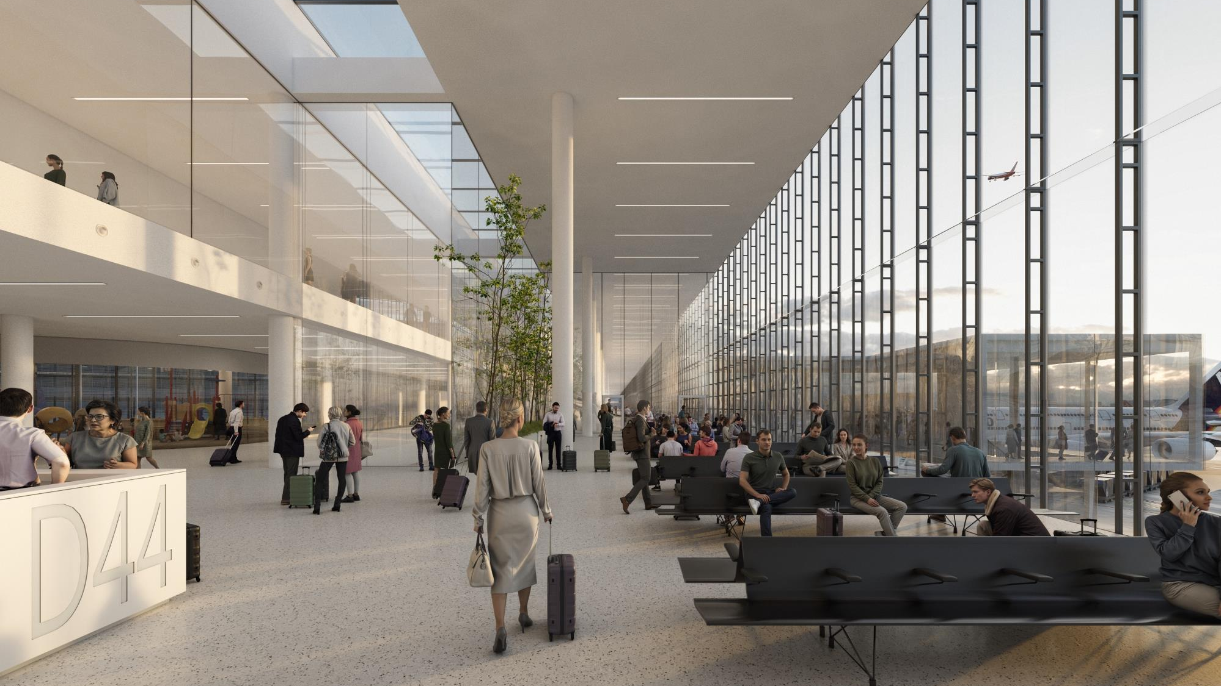
TERMINAL 2 EXPANSION – PIER D GATES

Slide 20
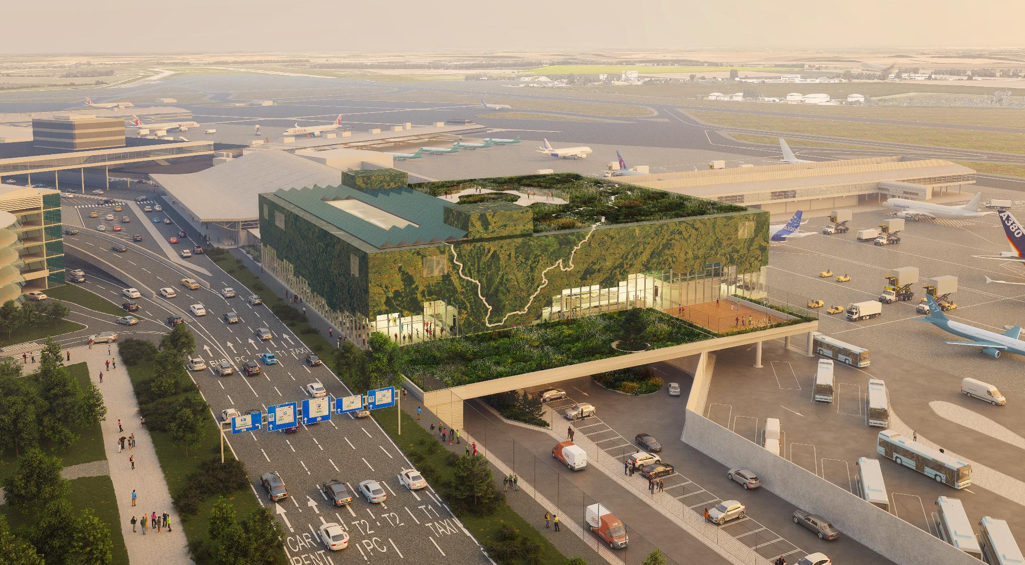
TERMINAL 1 EXPANSION

Slide 21
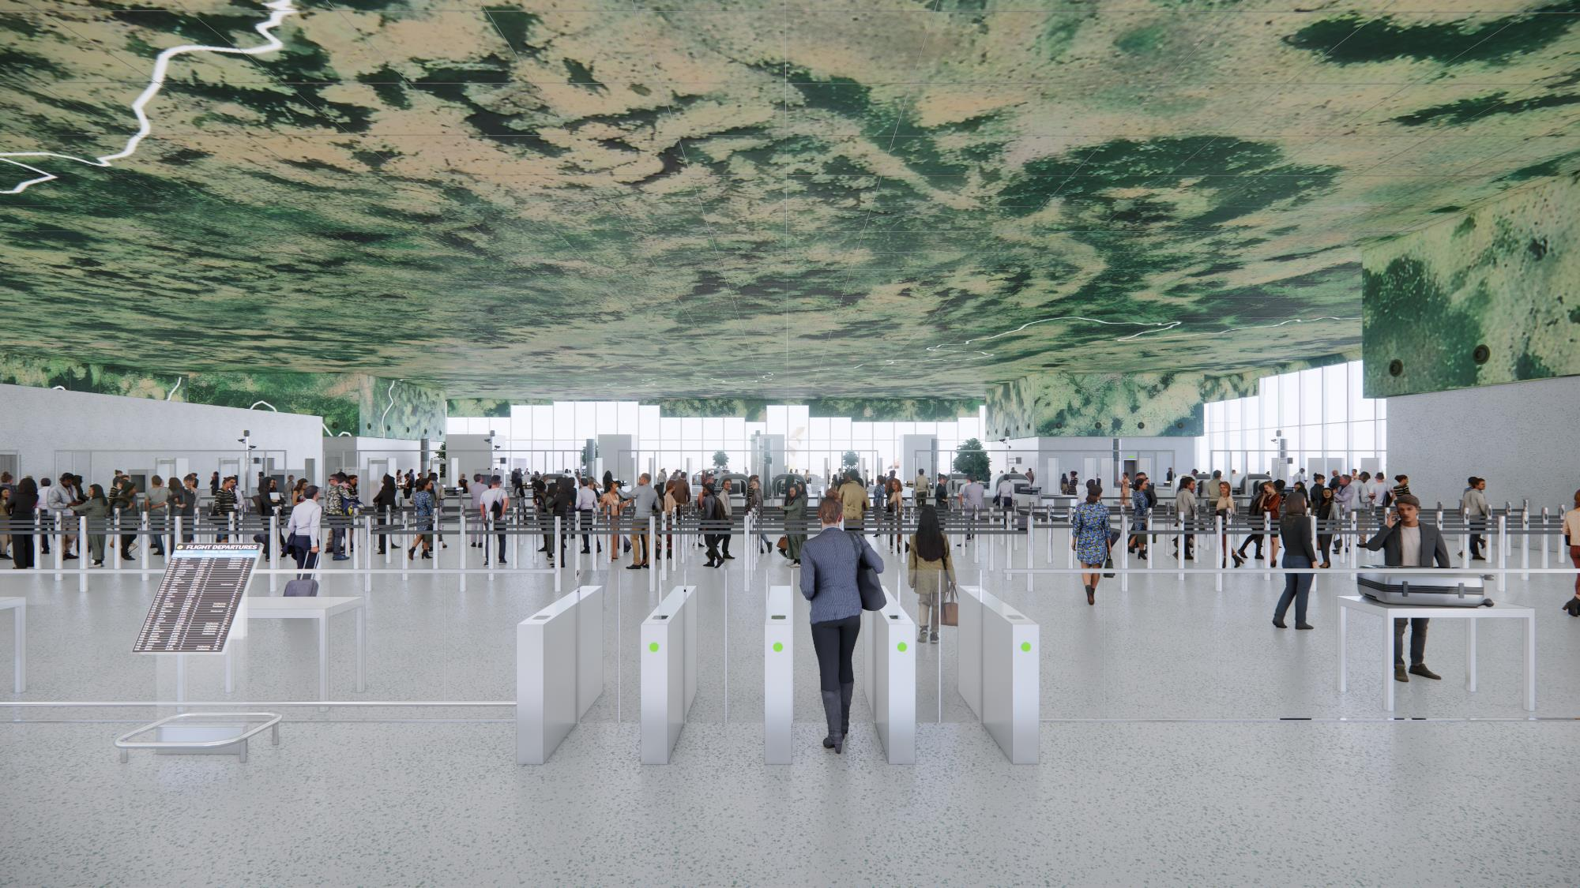
TERMINAL 1 EXPANSION - SECURITY

Slide 22
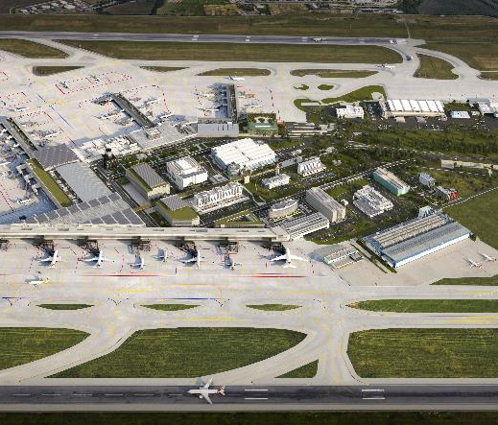
STAGE 3: MODERNISATION OF RUNWAY SYSTEM
PARALEL RUNWAY SYSTEM
A parallel runway system will allow the airport to increase resilience, better manage future demand and introduce important changes for our neighbourhood, including the closure of the transverse runway and a night curfew between 00:00 and 05:30.
PARALLEL RUNWAY SYSTEM

Slide 23
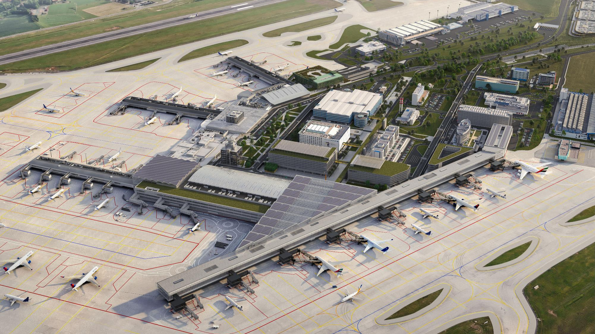
MODERNISATION PLAN 2030+

Slide 24
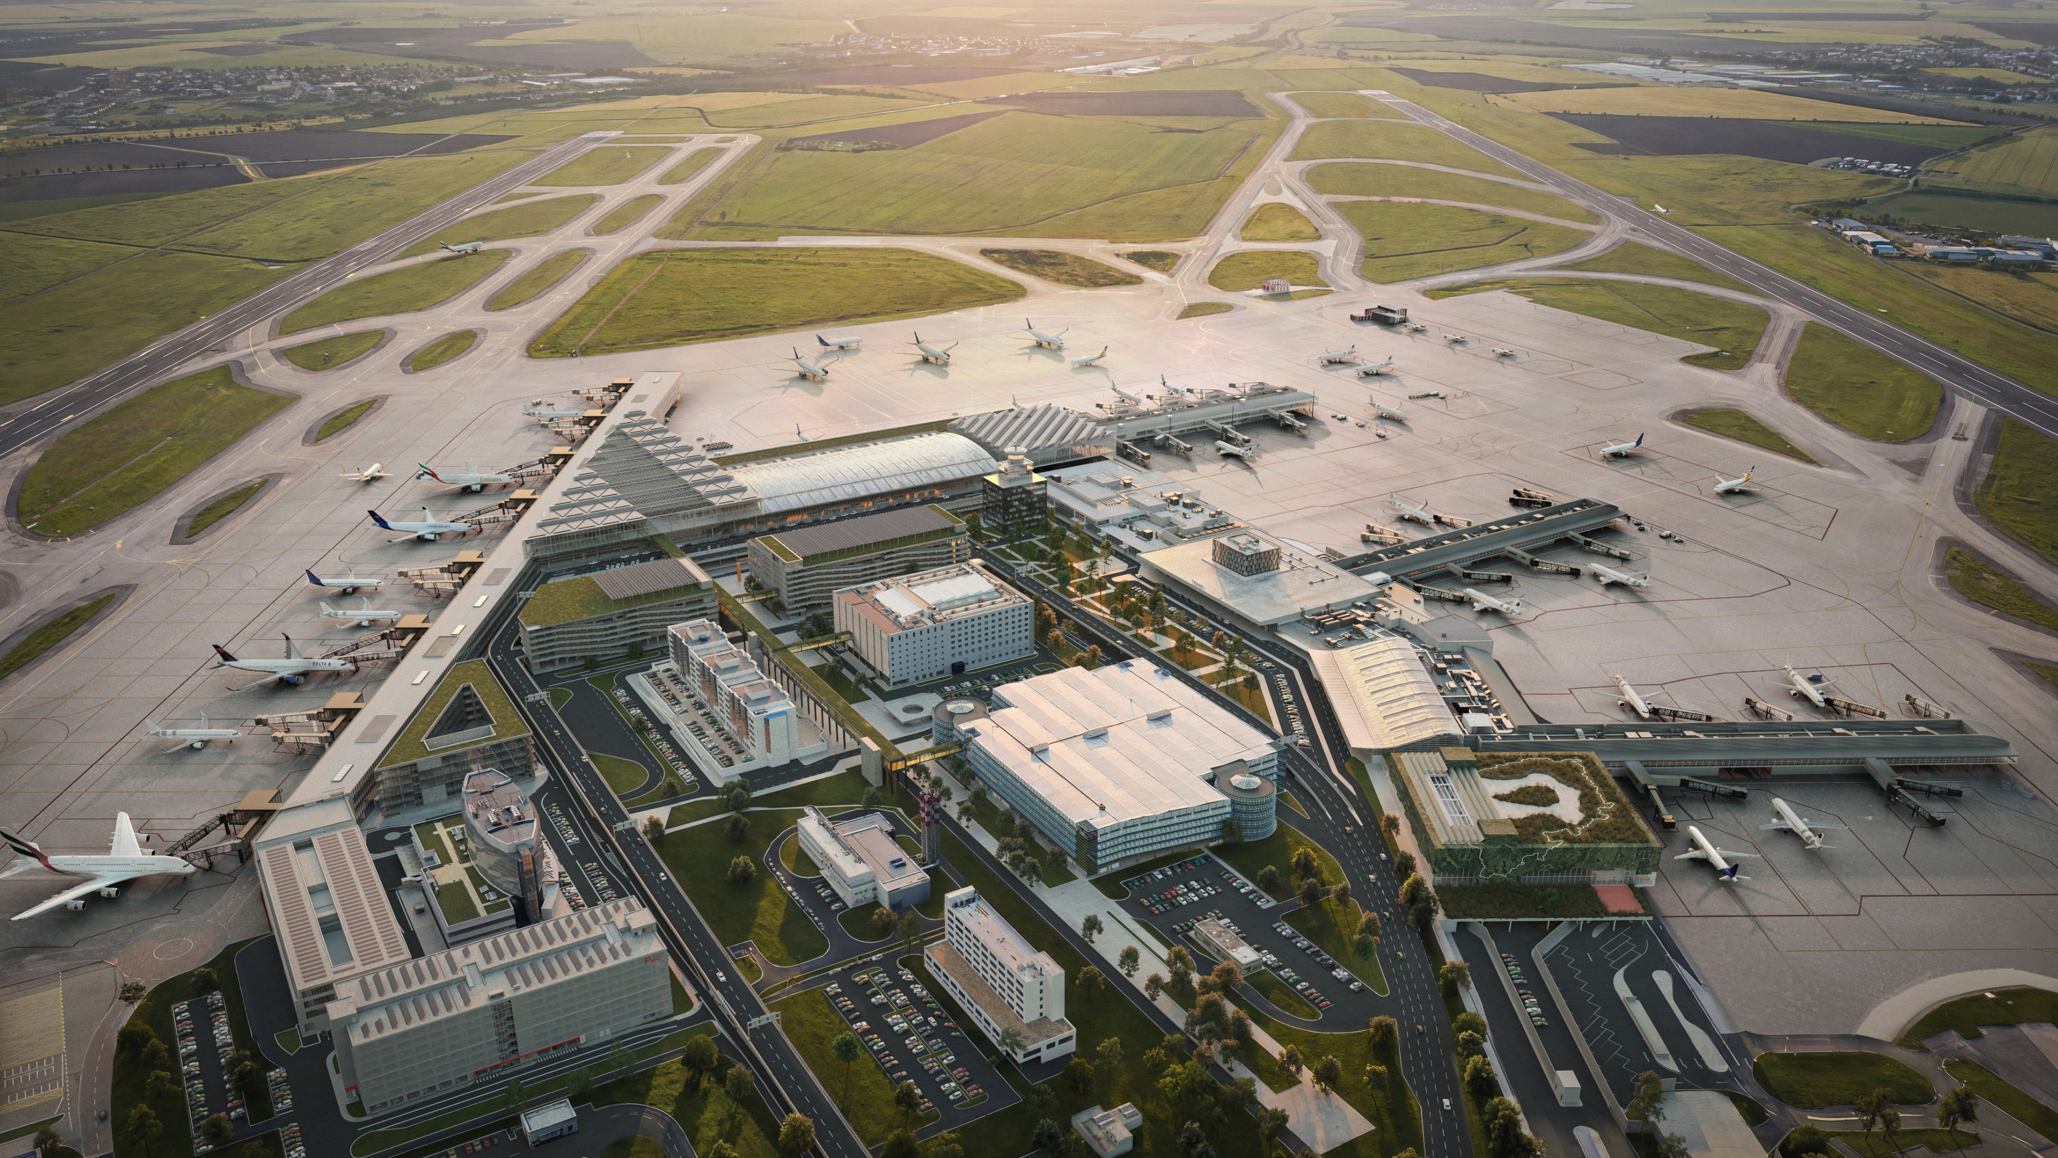
MODERNISATION PLAN 2030+

Slide 25
REMOVING TODAY’S BOTTLENECKS
CAPACITY AREA | 2025 | 2030 | 2035 | 2040
Total annual terminal capacity
Security screening at Terminal 1
Security screening at Terminal 2
Non-Schengen border control
RWY system
Aircraft stands – contact
Aircraft stands – remote
Parking capacity for passengers

Slide 26




BENEFITS FOR EVERYONE
FOR PASSENGERS
FOR BUSINESS AND ECONOMY
FOR OUR NEIGHBOURS
FOR THE FUTURE
30+ new destinations
15 new long-haul flights
3,500 new parking spaces
8,400+ m² of lounges
5,000+ m² of retail
Strong economic boost: +8.5B CZK from tourism spending*
GDP +3.2B CZK*
Jobs and regional impact: approximately +3,850 jobs*
Night curfew between 00:00 and 05:30
Closure of the existing runway 12/30
Lower emissions thanks to the airport connection to the railway and efficient air traffic
Less noise thanks to the night curfew
*KPMG Macroeconomic study, 2024

Slide 27
COORDINATED PROGRAMME, NOT ISOLATED PROJECTS
Modernisation works only if the airport develops as one connected systém.
Landside access, terminals, aircraft stands and runway capacity are interdependent.
The programme is phased to remain operationally manageable.
Each stage prepares the airport for the next one.
Coordination with transport infrastructure, public administration and key partners is essential.

Slide 28

THANK YOU
FOR YOUR TIME
Martin Kučera, Member of the Board of Directors

