Slide 1

Global Economics Intelligence by McKinsey
June 2026

Slide 2
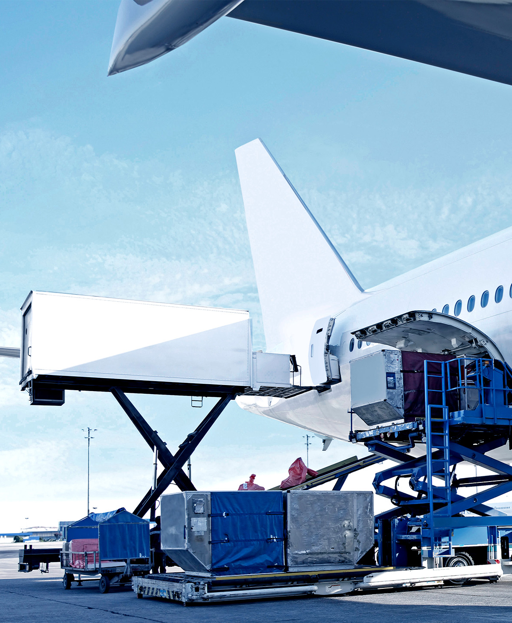

3 topics for today
State of the industry
Key trends
Opportunities

Slide 3
In 2024 airports created economic losses
Economic profit, USD billion
Positive EP
Negative EP
0.9
0.9
0.2
0
2.8
0.3
Manufac-turers
Lessors
ANSP³
Fuel production⁴
Airports
Catering
Ground services
MRO
Airlines
Freight forwarders
GDS /
travel tech
Aggregate
Economic profit/
revenue², %
-3.5%
+1.4%
+3.1%
-0.1%
-2.8%
+1.1%
-0.7%
+0.1%
-1.0%
+2.8%
+3.2%
Change vs. av.
2012-2019, USD bln
-5.4
+0.8
-0.7
-2.0
-6.6
-0.3
-1.3
-0.2
+11.0
+1.3
+0.2
Based on invested capital including goodwill, extrapolated to total industry. Not a zero-sum setup, possible for all subsectors and the ecosystem as total to be positive;
Computed as cumulative economic profit divided by cumulative sector revenue over the period; 3. Air Navigation Service Providers; 4. Typically value creating, but 2024 saw relatively lower crude oil prices
Source: CapitalIQ; The Airline Analyst; Bloomberg; GSCi; IATA; ACI; Company reports

Slide 4
Airlines continued to show negative economic profit in 2025
Airline industry ROIC including goodwill vs. median WACC, 1996-2025, percent
Median WACC
ROIC including goodwill
10
8
6
4
2
0
1996
98
00
02
04
06
08
10
12
14
16
18
20
22
24
26
-2
-4
-6
-8
-10
-12
-14
Source: McKinsey aviation value chain model

Slide 5
From 2012 to 2019, airports delivered positive average
Economic Profit
Economic profit, USD billion
Positive EP
Negative EP
1.0
0.2
2.2
0.5
1.7
1.6
1.6
0.1
1.5
0.1
-10.4
-20.9
Manufac-turers
Lessors
ANSP
Fuel production
Airports
Catering
Ground services
MRO
Airlines
Freight forwarders
GDS /
travel tech
Aggregate
Economic profit / revenue, %
+1.1%
+0.2%
+6.0%
+0.9%
+1.6%
+3.1%
+3.4%
+0.6%
-2.8%
+1.6%
+1.5%
Source: CapitalIQ; The Airline Analyst; Bloomberg; GSCi; IATA; ACI; Company reports

Slide 6
Europe airports back to positive value creation but not at 2019 levels
Economic profit, USD billion
North America
Europe
Asia Pacific
Rest of world
6
4
2
0
2012
13
14
15
16
17
18
19
20
21
22
23
2024
-2
-4
-6
-8
-10
-12
-14
-16
-18
Source: CapitalIQ; The Airline Analyst; Bloomberg; ACI; Company reports

Slide 7
Non-aeronautical revenues vital to airports' profitability but flatlining
Average airport revenue split, global, %
Aeronautical
revenues
1990
Non-aeronautical
revenues
1990
1995
2000
2006
2008
2010
2013
2014
2015
2016
2017
2018
2019
2020
2021
2022
2023
2024
  Era of fast increase in non-aero through focus on commercial activities
  Stabilization of revenue split, partly driven by higher airport tariffs
  Slight decline in non-aero revenue, driven by Euro-area downturn
  Stabilization of revenue split
  COVID-19
  Post COVID-19
Source: ACI

Slide 8
Key trends are redefining the aviation landscape
Deep-dive next
Traffic profile
Profitability
Structural shift
A1
Jet fuel cost pressure
B1
Evolving consumer preferences
C1
Increasing need for expansion
A2
Premium leisure increase
B2
Continuing inflationary pressures
C2
Decarbonization paths diverging
A3
LCCs expanding
C3
Robotics and automation usage growing
C3
Operational disruptions intensifying
C4
(Gen)AI fundamentally transforming ops & overhead
McKinsey & Company
8

Slide 9
A1 | Current jet fuel prices will influence airline profitability and passenger demand, but these levels are not unheard of
Nominal and real¹ jet fuel prices by month, Jul 1991 – Jun 2026 (until Jun 3rd), USD/barrel
Nominal jet fuel price
Real jet fuel price
June 2008 saw strong energy demand, constrained supply, geopolitical risks, and a weak USD
2011 and 2012 saw high jet fuel pricing – yet industry operating profitability that year was +3.1% and +2.6% respectively
270
240
210
200
180
150
120
90
60
30
0
1991
93
94
95
96
97
98
99
2000
01
02
03
04
05
06
07
08
09
10
11
12
13
14
15
16
17
18
19
20
21
22
23
24
25
26
1. February 2026 price levels
Source: Argus Media Group; BLS

Slide 10
A1 | Compared to other disruptions, the current Gulf crisis affects a larger share of global energy vs. any other crisis in the last century
Overview of selected energy supply shocks and impact on global energy system
(Geopolitical) Supply disruption
(Geopolitical) Chokepoint disruption
Natural disasters & force majeure
Weekly energy impacted (mtoe)
20%
?
15%
Energy impact (% of global energy demand)¹
2026 Strait of Hormuz disruption²
10%
1967 Straits of Tiran Blockade
1973 Arab Oil Embargo
1960 Suez Canal Closure
2019 Abqaiq–Khurais attack
2021 Evergreen ship Suez
1978 Iranian Revolution
1990 Gulf War
5%
1950s Suez Crisis
1980s Iran–Iraq War
2017 Hurricane Harvey
2005 Hurricanes Katrina & Rita
?
2016 Canadian Wildfires
2011 Libyan Civil War
2022 Russia–Ukraine War²
0%
0
10
20
30
40
50
200
420
Duration of disruption (# of weeks)
1. Defined as the share of global energy demand impacted by the crisis; 2. Ongoing
Source: IEA historic energy balances, press search
McKinsey & Company
10

Slide 11
A1 | Europe is most exposed to supply disruption given large demand, import dependence, and large Middle East-linked supply exposure
Top 10 global jet fuel demand by source, MMb/d, 2025
United States
1.8
Domestic production
Imports from Europe
China
0.9
Middle East
Japan
0.4
Asia
Africa
Imports
United Kingdom
0.3
USA
Other
UAE
0.2
Exports
France
0.2
Australia
0.1
Italy
0.1
Mexico
0.1
Netherlands
Source: Energy Aspects

Slide 12
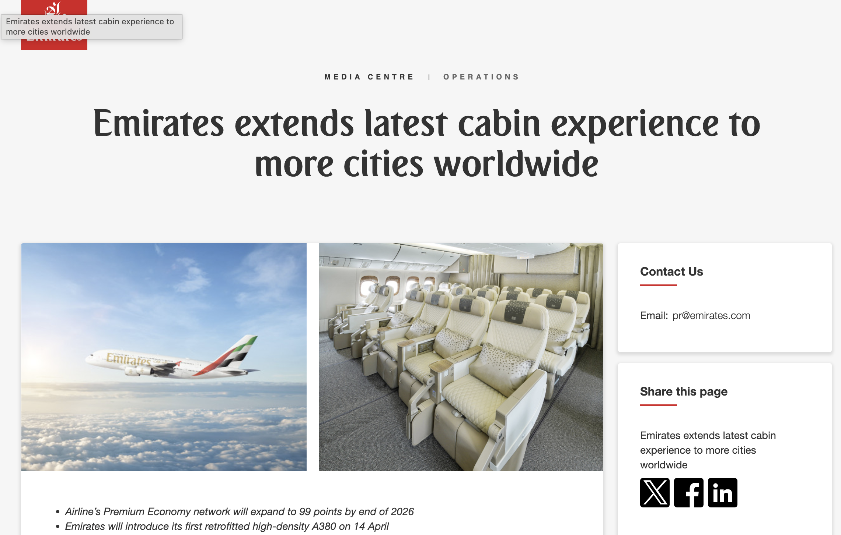


A2 | Airlines have steadily increased premium capacity over the years, driven by premium leisure growth
xx%
Share of business and first class seats out of total
Available first and business class seats, from Europe, mn
11.0%
10.5%
11.1%
11.2%
11.8%
+2.5% p.a.
158
165
153
135
136
2016
17
18
19
2024
Source: Diio Mi

Slide 13
B1 | Post-COVID consumer behaviour shifts driving declines in non-aeronautical revenues
Average spend per passenger, USD, Global
Key drivers of trends
-18%
  Cost of living: expendable income is lower across the board and prices have gone up
  Shift to digital consumption: growth in e-commerce and younger passengers expecting omnichannel experiences
  Reduced dwell-time: partly driven by better information (apps) and by improved process times
2016
17
18
19
20
21
22
23
24
2025
13
Source: Generation research, ACI
13

Slide 14










B3 | Automation and digitization opportunity
Autonomous Vehicles
Passenger Bridges
Automated Baggage Handling
Drone Surveillance
Digitalization
20-30% of airport operations FTE are involved in driving tasks
>20% reduction in docking time using semi-/fully-automated PBB
~35% reduction in baggage handling time using automated conveyor belts
70% fewer bird strikes through drone usage
20% increase in staff efficiency with dynamic workforce management

Slide 15
B4 | We typically see AI & digital driving at least 15-30% EBITDA uplift for airports
Top area of impact¹, % respondents
Conservative case
Full potential
Core area
Value range, % EBITDA
Examples
Customer insights & Commercial revenue
  Multi-data source customer segmentation & recognition
  Advanced pricing models for service, parking, lounges
  Dwell time management
~5-10%
25%
  AI-enabled dynamic gate allocation and staffing
  Predictive delay & disruption recovery
  Collaborative data platforms
Operational performance
~5-10%
42%
  Digital twin to improve asset planning and construction
  Predictive repair & maintenance tools
  Smart energy systems to optimize utility consumption
Capex & asset management
~3-6%
8%
Digitized administrative functions
  Automated variance analysis to reduce manual reporting
  Rolling budget forecasts and anomaly detection
~2-4%
25%
Total value at stake
~15-30%
1. Question: In what area have you seen the biggest impact?, McKinsey Airport Survey

Slide 16

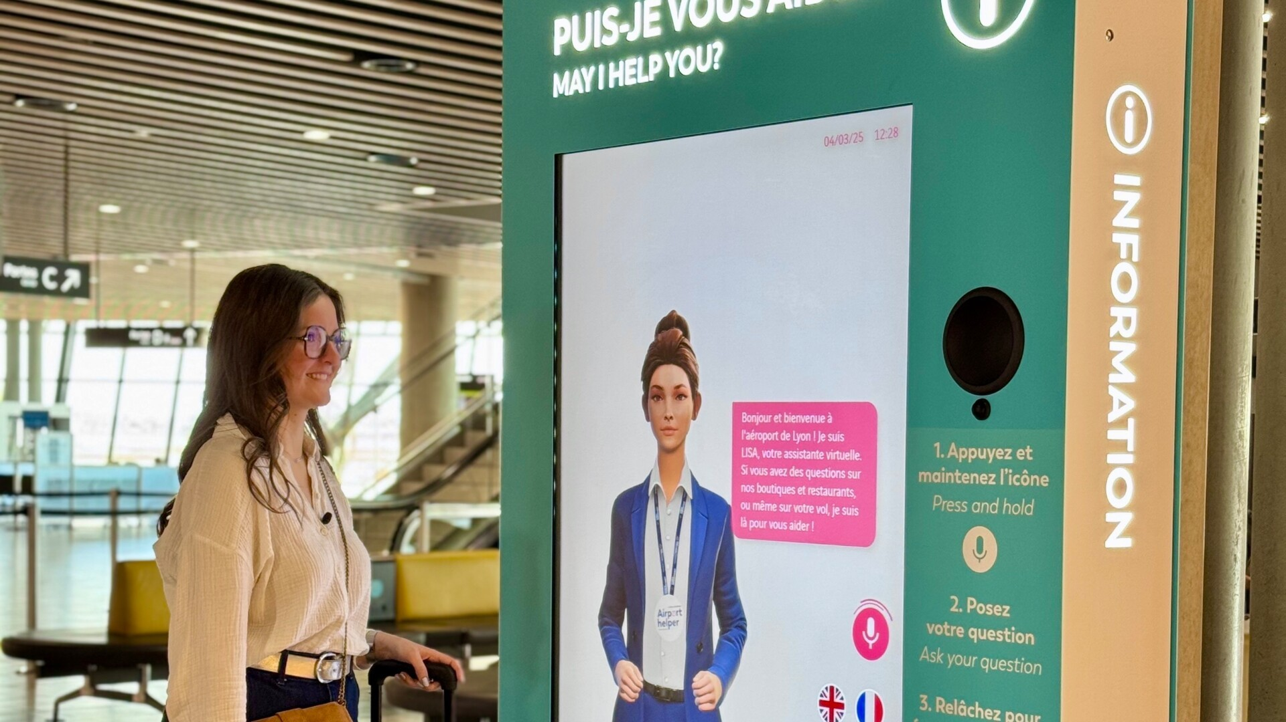

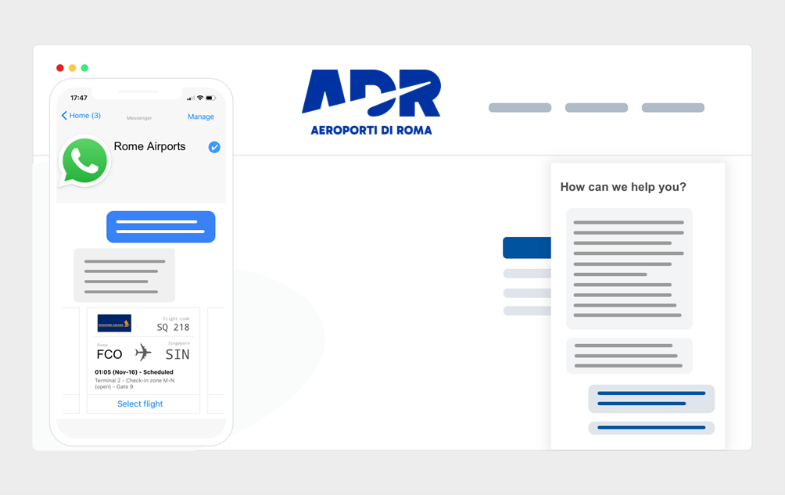

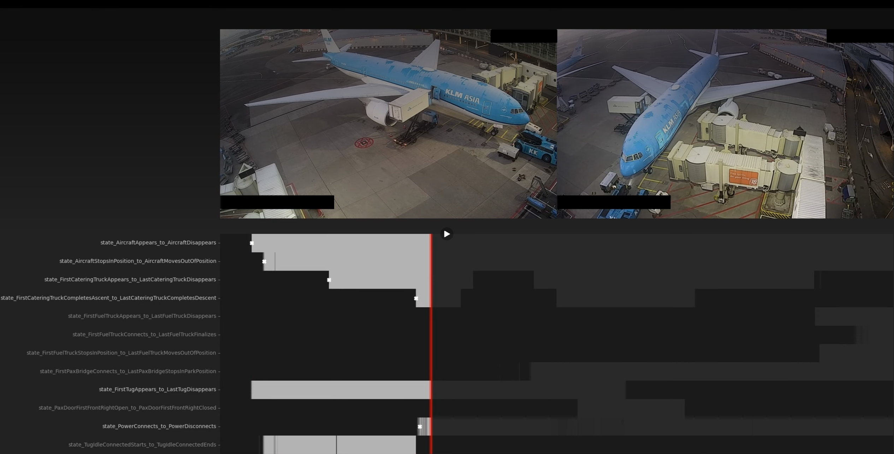

B4 | Airports are beginning to pilot and scale Agentic AI
Airports
Use Cases
Launched a GenAI-powered virtual agent for terminals
Introduced “AI@Fraport” program, including “FraportGPT,” an internal chatbot designed to assist employees with daily operations
Implemented an AI-driven virtual assistant (accessible through website & WhatsApp): provides real-time flight, parking, and baggage updates with multilingual functionality
Implemented AI-driven turnaround solution enhancing aircraft handling with real-time insights, and predictive disruption alerts
Notes:
While ~80% of organizations experimenting with or scaling Agentic AI also scaled GenAI, it is possible to “leapfrog” GenAI capabilities and move directly into Agentic AI efforts
Agentic allows to mimic human team behaviors, speeding up self-learning, predictive power and improved autonomous decision-making
In airport context, separate agents can check compliance, safety and other boundary conditions, whilst increasing response speed

Slide 17
C1 | Many European airports are advancing expansion plans
Announced airport CAPEX investment
AMS terminal upgrade and expansion | ~$11bn
FRA terminal construction and upgrade | ~$7bn
LHR terminal and airfield expansion | $30-65bn
CPK greenfield multi-modal hub| ~$30bn
AENA network airports expansion incl. BCN and MAD | ~$14bn
CDG terminal and airfield expansion and upgrades | ~$10bn
Source: Momberger Airport Information

Slide 18
C1 | European airports pursue growth amid complex expansion challenges
CAPEX challenges at airports
Typical European Hub airport figures
10s-100s
of internal and external consultations to start a new project
Airports are regulated environments with multiple stakeholders and high public visibility (e.g., airlines, border control, airport operations, commercial business partners) that often have conflicting objectives
Stakeholder alignment
4-6
Hour airside construction windows with full daily demobilization
Moreover, many projects are executed in a highly complex 24/7 live operational environment with limited ability to absorb shutdowns and other disruption
Operational environment
80-90%
Projects with major cost and/or schedule overruns
As a result, budgets and timelines are higher/longer versus comparable non-airport construction and even with these buffers, project overruns are common
Cost and schedule predictability
2x
Expected passenger growth by 2040
This problem will increase as airport infrastructure investment is accelerating due to passenger
demand growth
Future growth

Slide 19
Opportunities for airports
Continue focus on non-aero revenues, as demand slows and LCC growth increases pressure on aero revenues
Opportunities in premium services, property, innovative retail formats
Cost management remains crucial, and new technologies can support next wave of automation
Potential new business models, providing more services along the ecosystem, driven by automation technologies

